Slide 1

18.404/6.840 Lecture 23
Last time: - ${EQ}_{REX↑}$ is EXPSPACE-complete
- Thus ${EQ}_{REX↑}∉$ PSPACE
- Oracles and P versus NP
Today: (Sipser §10.2) - Probabilistic computation
- The class BPP
- Branching programs
1

Slide 2

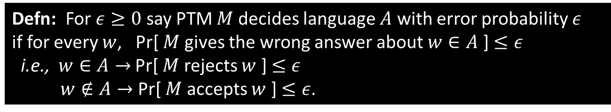

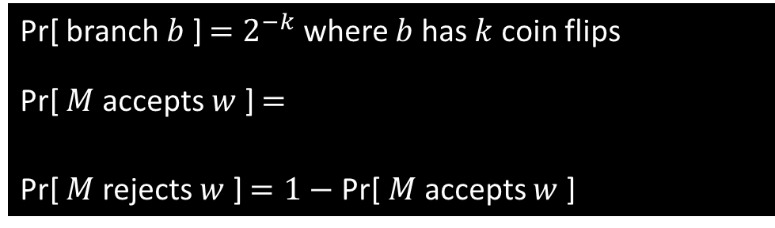

Probabilistic TMs
Defn: A probabilistic Turing machine (PTM) is a variant of a NTM where each computation step has 1 or 2 possible choices.
deterministic
step
coin flip step -
each choice has 50% probability
computation tree for $M$ on $w$
Pr[ branch $b$ ] $=2^{−k}$ where $b$ has $k$ coin flips
Pr[ $M$ accepts $w$ ] $=$
Pr[ $M$ rejects $w$ ] $=1−$Pr[ $M$ accepts $w$ ]
$$\sum_{\text{b} \text{accepts} }{Pr⁡[ \text{branch} b ]}$$
branch $b$
Defn: For $ε≥0$ say PTM $M$ decides language $A$ with error probability $ε$ if for every $w$, Pr[ $M$ gives the wrong answer about $w∈A$ ] $≤ε$
i.e., $w∈A→$ Pr[ $M$ rejects $w$ ] $≤ε$
$w∉A→$ Pr[ $M$ accepts $w$ ] $≤ε$.
2

Slide 3

The Class BPP
Defn: BPP $=\left\{A\right|$some poly-time PTM decides $A$ with error $ε=1/3$ }
Amplification lemma: If $M_{1}$ is a poly-time PTM with error $ε_{1}<1/2$ then, for any $0<ε_{2}<1/2$, there is an equivalent poly-time PTM $M_{2}$ with error $ε_{2}$.
Can strengthen to make $ε_{2}<2^{\text{−}poly\left(n\right)}$.
Proof idea: $M_{2}=$ “On input $w$
1. Run $M_{1}$ on $w$ for $k$ times and output the majority response.”
Details: Calculation to obtain $k$ and the improved error probability.
Significance: Can make the error probability so small it is negligible.
3

Slide 4

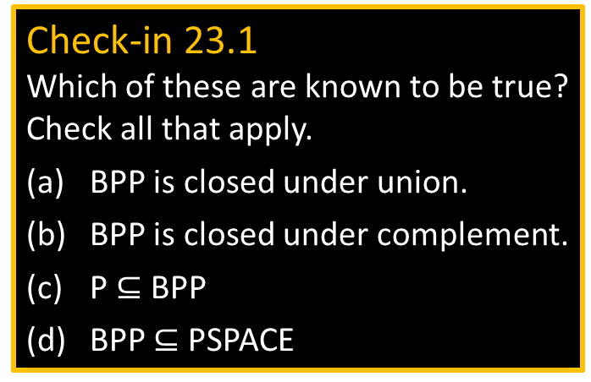



NP and BPP
NP
BPP
Computation trees for $M$ on $w$
$$w∈A$$
$≥1$ accepting
Many accepting
Few rejecting
Check-in 23.1
Which of these are known to be true?
Check all that apply.
BPP is closed under union.
BPP is closed under complement.
P $⊆$ BPP
BPP $⊆$ PSPACE
$$w∉A$$
all rejecting
Few accepting
Many rejecting
4
Check-in 23.1

Slide 5







Example: Branching Programs
Defn: A branching program (BP) is a directed, acyclic (no cycles) graph that has
1. Query nodes labeled $x_{i}$ and having two outgoing edges labeled 0 and 1.
2. Two output nodes labeled 0 and 1 and having no outgoing edges.
3. A designated start node.
BP $B$ with query nodes $x_{1},…, x_{m}$ describes a Boolean function $f:{\left\{0,\text{1}\right\}}^{m}→\{0,\text{1}\}$:
Follow the path designated by the query nodes’ outgoing edges from the start note until reach an output node.
Example: For $x_{1}=\text{1}, x_{2}=\text{0}, x_{3}=\text{1}$ we have $f\left(\text{101}\right)=0=$output.
BPs are equivalent if they describe the same Boolean function.
Defn: $EQ\text{BP}$ $=\left\{〈B_{1},B_{2}〉\right| B_{1}$ and $B_{2}$ are equivalent BPs (written $B_{1}≡B_{2}$) }
Theorem: $EQ\text{BP}$ is coNP-complete (on pset 6)
$EQ\text{BP}∈$ BPP ? Unknown. That would imply NP $⊆$ BPP and would be surprising!
Instead, consider a restricted problem.
$$x_{1}$$
0
1
$$x_{2}$$
$$x_{3}$$
0
1
0
1
$$x_{3}$$
1
$$x_{1}$$
0
$$x_{2}$$
0
1
0
1
0
1
5

Slide 6





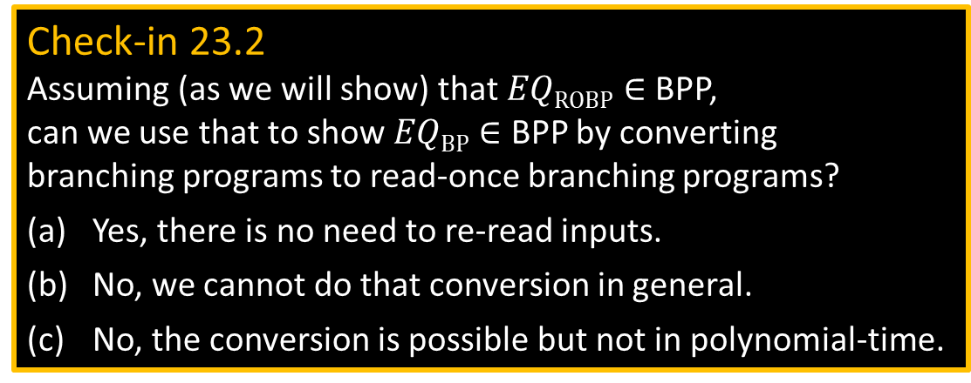


Read-once Branching Programs
Defn: A BP is read-once if it never queries a variable more than once on any path from the start node to an output.
Defn: $EQ\text{ROB}\text{P}$ $=\left\{〈B_{1},B_{2}〉\right| B_{1}$ and $B_{2}$ are equivalent read-once BPs$\}$
Theorem: $EQ\text{ROBP}∈$ BPP
$$x_{1}$$
0
1
Check-in 23.2
Assuming (as we will show) that $EQ\text{ROBP}∈$ BPP, can we use that to show $EQ\text{BP}∈$ BPP by converting branching programs to read-once branching programs?
Yes, there is no need to re-read inputs.
No, we cannot do that conversion in general.
No, the conversion is possible but not in polynomial-time.
$$x_{2}$$
$$x_{3}$$
0
1
0
1
$$x_{3}$$
1
$$x_{1}$$
0
$$x_{2}$$
0
1
0
1
0
1
Not read-once
6
Check-in 23.2

Slide 7






$EQ\text{ROBP}∈$ BPP
Theorem: $EQ\text{ROBP}∈$ BPP
Proof attempt: Let $M =$“On input $〈B_{1},B_{2}〉$
1. Pick $k$ random input assignments and evaluate $B_{1}$ and $B_{2}$ on each one.
2. If $B_{1}$ and $B_{2}$ ever disagree on those assignments then reject. If they always agree on those assignments then accept.”
What $k$ to chose?
If $B_{1}≡B_{2}$ then they always agree so Pr[ $M$ accepts $〈B_{1},B_{2}〉$ ] $=$ 1
If $B_{1}≢B_{2}$ then want Pr[ $M$ accepts $〈B_{1},B_{2}〉$ ] $≤1/3$
so want Pr[ $M$ rejects $〈B_{1},B_{2}〉$ ] $≥ 2/3$ .
But $B_{1}$ and $B_{2}$ may disagree rarely, say in 1 of the $2^{m}$ possible assignments.
That would require exponentially many samples to have a good chance of finding a disagreeing assignment and thus would require $k>\left(2/3\right)2^{m}$.
But then this algorithm would use exponential time.
Try a different idea: Run $B_{1}$ and $B_{2}$ on non-Boolean inputs.
$$B_{1}$$
$$B_{2}$$
$$x_{1}$$
$$x_{4}$$
0
1
0
1
0
1
0
1
7

Slide 8














Boolean Labeling
Alternative way to view BP computation
Show by example: Input is $x_{1}=\text{0}, x_{2}=\text{1}, x_{3}=\text{1}$
The BP follows its execution path.
Label all nodes and edges on the execution path with 1
and off the execution path with 0.
Output the label of the output node 1.
$x_{1}$
1
1
0
1
0
1
$$x_{2}$$
$$x_{2}$$
0
1
0
Obtain the labeling inductively by using these rules:
0
1
0
1
0
0
0
1
$$a$$
$x_{i}$
$$a_{2}$$
$x_{3}$
$$x_{3}$$
1
0
$$a_{1}$$
$$a_{3}$$
0
0
0
1
$$a∧\overline{x_{i}}$$
0
1
0
1
$$a∧x_{i}$$
$$a_{1}∨a_{2}∨a_{3}$$
0
0
1
1
Label edges from nodes
Label nodes from incoming edges
8

Slide 9

















Arithmetization Method
Method: Simulate $∧$ and $∨$ with $+$ and $×$.
$a∧b → a×b=ab$
$\overline{a} → \left(1−a\right)$
$a∨b → a+b−ab$
$x_{1}$
0
1
Replace Boolean labeling with arithmetical labeling
Inductive rules:
Start node labeled 1
$$x_{2}$$
$$x_{2}$$
1
0
0
1
$$a_{2}$$
$x_{3}$
$$x_{3}$$
$$a$$
$$a_{1}$$
$$a_{3}$$
1
0
$x_{i}$
0
1
0
1
$$a_{1}+a_{2}+a_{3}$$
$$a∧\overline{x_{i}}$$
$$a_{1}∨a_{2}∨a_{3}$$
$$a (1−x_{i})$$
$$a x_{i}$$
$$a∧x_{i}$$
Works because the BP is acyclic.
The execution path can enter a node at most one time.
0
1
9

Slide 10
























Non-Boolean Inputs
Use the arithmetized interpretation of the BP’s computation to define its operation on non-Boolean inputs.
Example: $x_{1}=\text{2}, x_{2}=\text{3}$ Output = $−7$
Recall labeling rules:
1
$x_{1}$
$$a$$
$x_{i}$
$$a_{2}$$
0
1
$$a_{1}$$
$$a_{3}$$
0
1
$$a (1−x_{i})$$
$$a x_{i}$$
$$−1=1\left(1−2\right)$$
$$1\left(2\right)=2$$
$$a_{1}+a_{2}+a_{3}$$
$$−1$$
$$2$$
Check-in 23.3
What is the output for this branching program using the arithmetized interpretation if $x_{1}=1, x_{2}=y$ ?
$(1−y)$
$(y+1)$
$y$
$$x_{2}$$
$$x_{2}$$
Revised $M$ for $EQ\text{ROBP}$: “On input $〈B_{1},B_{2}〉$
1. Pick a random non-Boolean input assignment.
2. Evaluate $B_{1}$ and $B_{2}$ on that assignment.
3. If $B_{1}$ and $B_{2}$ disagree then reject. If they agree then accept.”
Correctness proof… after Thanksgiving.
0
1
1
0
$$2=−1\left(1−3\right)$$
$$2\left(1−3\right)=−4$$
$$−3=−1\left(3\right)$$
$$2\left(3\right)=6$$
$$8=2+6$$
0
1
$$\left(−3\right)+\left(−4\right)=−7$$
10
Check-in 23.3

Slide 11

Quick review of today
Defined probabilistic Turing machines
Defined the class BPP
Sketched the amplification lemma
Introduced branching programs and read-once branching programs
Started the proof that $EQ\text{ROBP}∈$ BPP
Introduced the arithmetization method
11

Slide 12
MIT OpenCourseWare
https://ocw.mit.edu
18.404J Theory of Computation
Fall 2020
For information about citing these materials or our Terms of Use, visit: https://ocw.mit.edu/terms.

